Slide 1
New apartment project
TORONTO VS NEW YORK

Slide 2
Problem statement
Identify the best location in Toronto or New York to build 500 unit luxury apartment
Identify specific borough in which this apartment complex should be built
Identify venues and amenities that renters can enjoy in the area

Slide 3
Data Used
Toronto data - https://en.wikipedia.org/wiki/List_of_postal_codes_of_Canada:_M
New York data - https://geo.nyu.edu/catalog/nyu_2451_34572
Foursquare API data
Longitude and Latitude - http://cocl.us/Geospatial_data

Slide 4
methoology
Foursquare API
The Foursquare API will be used to pull in data for both Queens and Scarborough neighborhoods using the same methodology that we did in the previous lab.
Foursquare API search feature would be enabled to collect the nearby places of the neighborhoods. Due to http request limitations the number of places per neighborhood parameter would reasonably be set to 100 and the radius parameter would be set to 700.
K-Means Clustering
Extensive comparative analysis of two randomly picked neighborhoods world be carried out to derive the desirable insights from the outcomes using python’s scientiﬁc libraries Pandas, NumPy and Scikit-learn.
Unsupervised machine learning algorithm K-mean clustering would be applied to form the clusters of diﬀerent categories of places residing in and around the neighborhoods. These clusters from each of those two chosen neighborhoods would be analyzed individually collectively and comparatively to derive the conclusions.

Slide 5
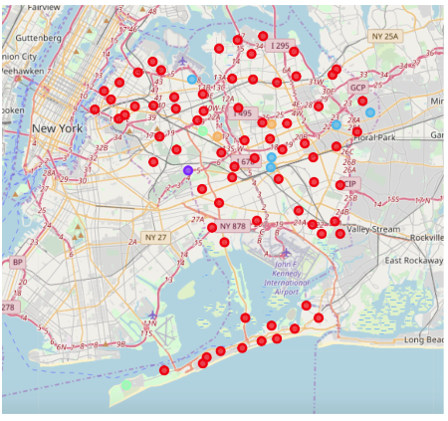
Results – Queens- NY

Slide 6
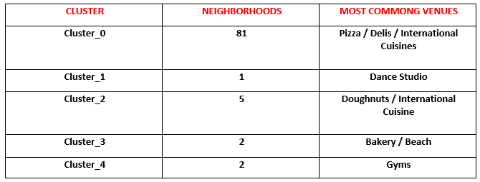
Queens - NY

Slide 7
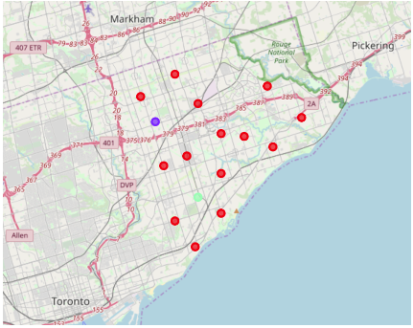
Scarborough – Toronto

Slide 8
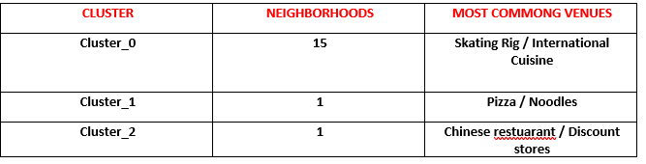
Scarborough - Toronto

Slide 9
Comparison of number of venues
Scarborough – 17 neighborhoods – 85 places of interest for potential renters to enjoy. However, outside of the skating rig there isn’t much that brings appeal to the area from an extracurricular standpoint.
Queens has 81 neighborhoods and a whopping 2108 places of interest that renters can enjoy. This along with its proximity to the ocean makes it an outstanding place to build luxury apartments.

Slide 10
Conclusion
Queens NY is the logical destination for an apartment complex
all depends on the cost of the build and how soon the company can break even – there may be a second analysis warranted to figure that out.

